Slide 1
Gamified LinkedIn Platform
Presented by Nadia Ben Slima, Kodie Donkor, Tony Christopher, Rivaldo Lumelino, Brian Perez
October 30, 2024

Slide 2

What
The idea is to offer both job seekers and company recruiters a digital and interactive platform to connect to one another. We can gauge users skills and capabilities through interactive quests and tasks and offer an easier filter of candidates to recruiters based on what they are looking for in potential future employees.

Slide 3
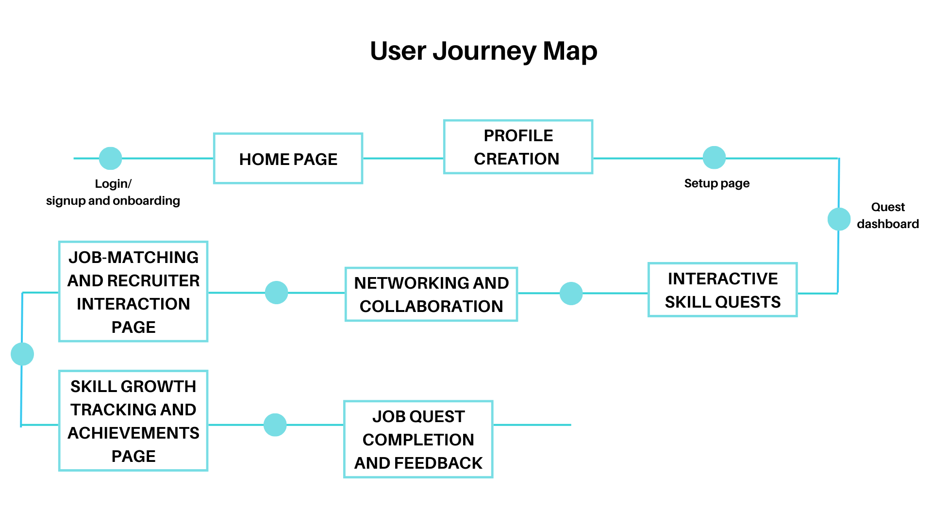

Slide 4
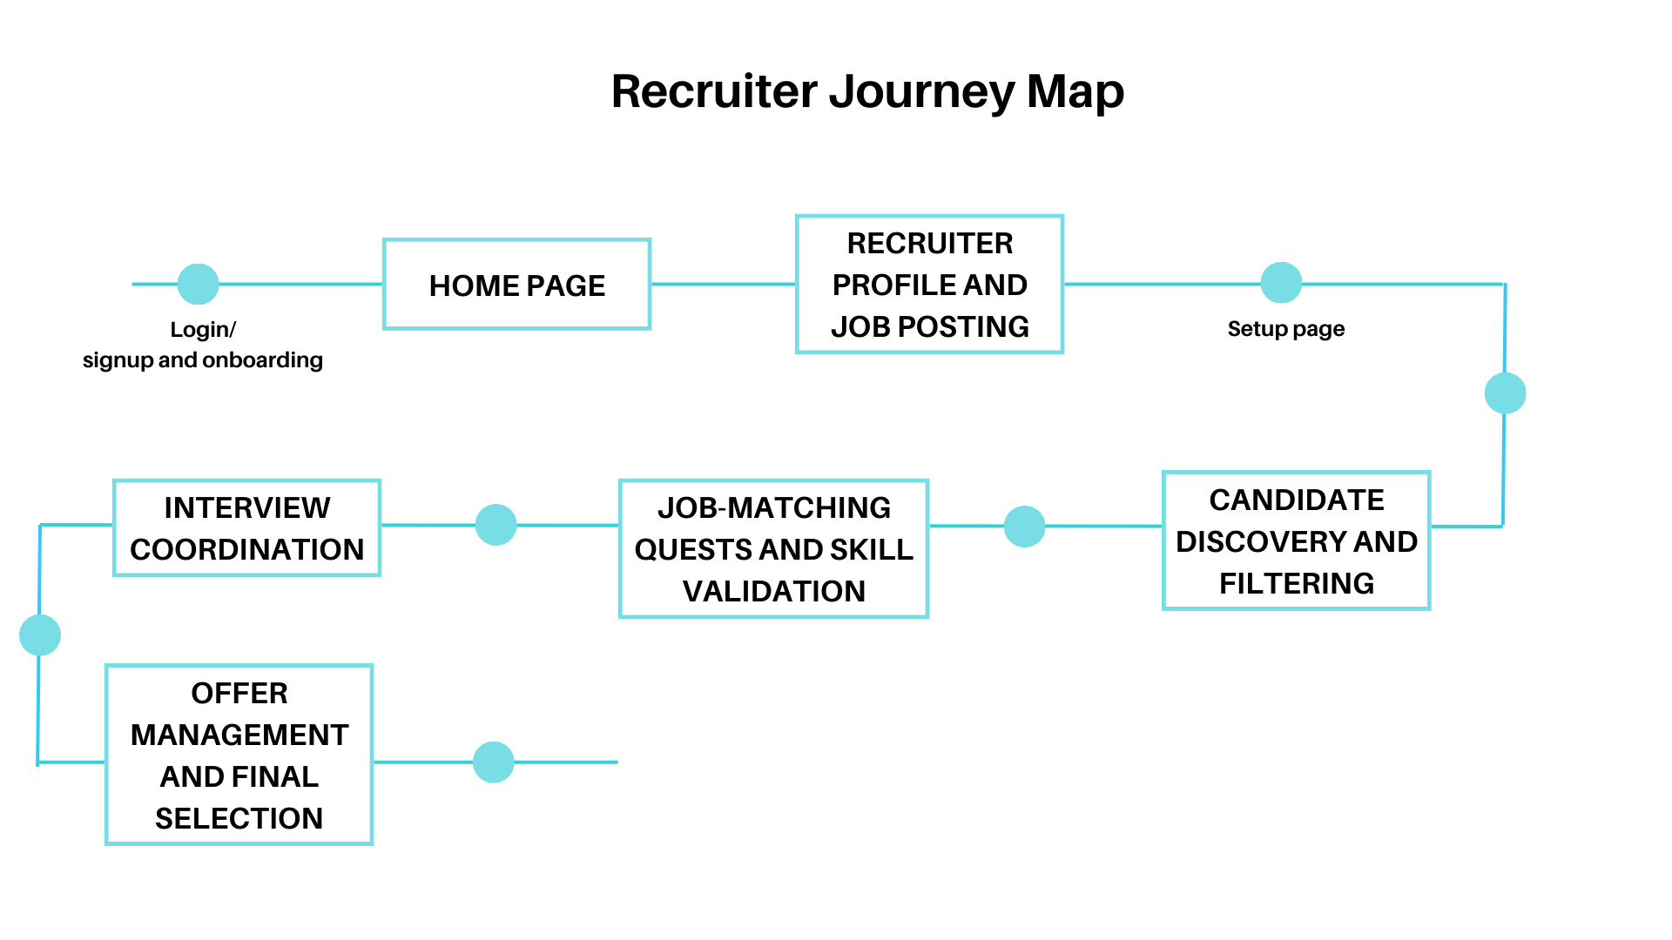

Slide 5

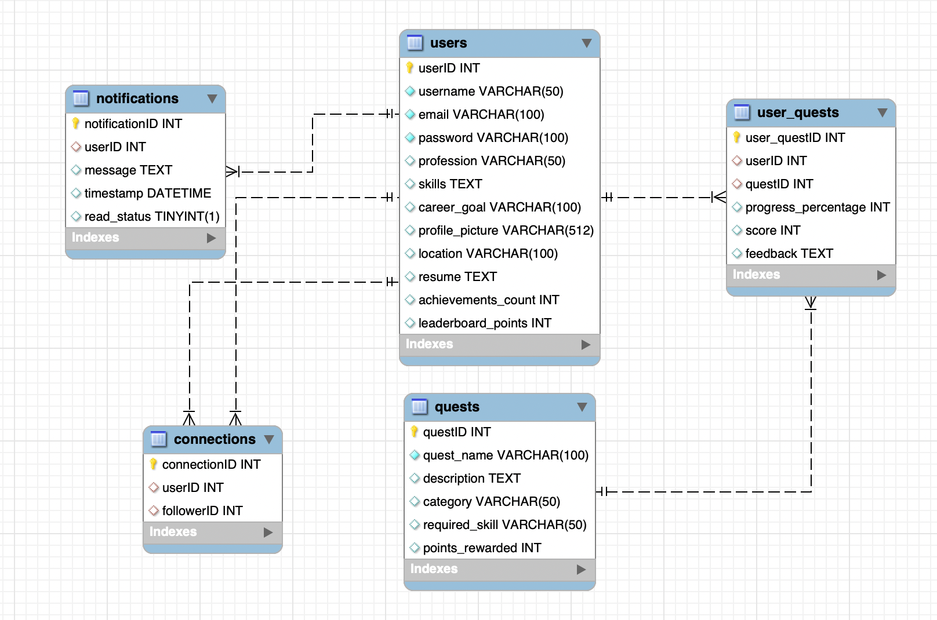
The Data
( Relational Data Model)

Slide 6




The Stack
Front End: React.js
Manage the connection between the database and the front-end, to ensure smooth handling of the quest data and user profile
Back End: Java
Very rich libraries
Maintainable and secure
Database: MySQL
Utilizing Docker
Scalability and cost of use
Docker: Ease of access to all tools and dependencies
Repository: Github

Slide 7
Member Roles
FRONT END
Nadia B
Rivaldo L
DATABASE
Tony C
Kodie D
BACK END
Brian P

Slide 8
Q&A?

